Slide 1

Bank CRM Analysis
Power BI Project By – Nidhi Roy
Tools Used – Power BI Desktop, MySQL Workbench, MS-Office
Platform – Newton School

Slide 2
Table of
Content
Introduction
Problem Statement
Data Overview (Schema)
Metrics and their Insights
Dashboard Snippets
Challenges Faced
Conclusion
Recommendations

Slide 3
Introduction
Welcome to this presentation on Customer Relationship Management within the banking sector. In my role as the bank’s Analytical CRM Specialist, I’ve undertaken a comprehensive review of multiple customer datasets to identify actionable insights that can reduce churn, enhance service quality, and elevate overall customer satisfaction.
In the following sections, we’ll walk through key customer demographics, transaction behaviors, exit patterns, and active account profiles. The objective is clear: leverage data-driven intelligence to support strategic decision-making and strengthen long-term customer engagement. Let’s begin our deep dive and explore how smart analytics can transform customer retention and satisfaction across the bank.

Slide 4
Problem Statement
You are an analytical CRM (Customer Relationship Management) specialist hired by a bank to extract meaningful insights from various customer- related datasets. The bank aims to reduce customer churn, improve service delivery, and enhance customer satisfaction. They have provided you with datasets including customer demographics, transaction details, customer exit information, and active customer profiles.

Slide 5
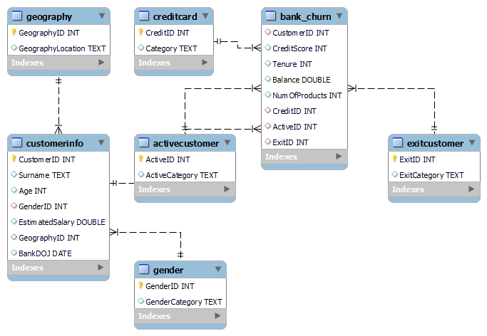
Data Overview (Schema)

Slide 6
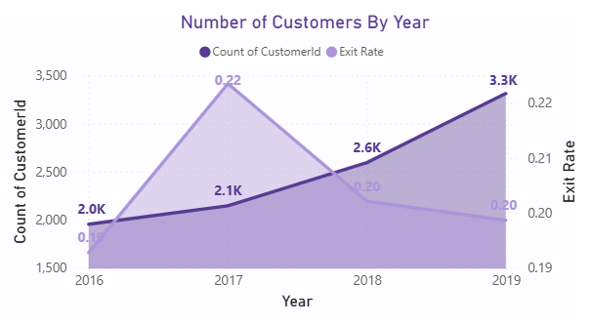
Number of Customers and Churn Rate by Year
Customer count grew steadily from 2.0K (2016) to 3.3K (2019), indicating strong acquisition.
Churn rate peaked at 22.4% in 2017 but improved to 19.9% by 2019, reflecting better retention strategies.
2019 was the most successful year with highest customer gain and lowest churn since 2017.

Slide 7
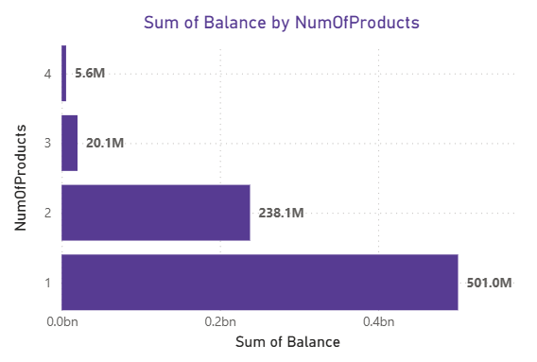
Total Balance by NumOfProducts
Single-product customers hold the highest balance at ₹501.04M, highlighting their dominant contribution.
As the number of products increases, total balance significantly decreases, with just ₹5.62M for 4 products.
This pattern suggests low multi-product adoption, indicating an opportunity for cross-selling and product bundling strategies.

Slide 8
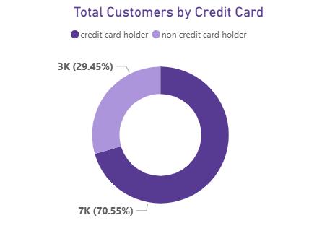
Number of Customers by Credit Card
Majority (70.55%) of customers are credit card holders, showing strong penetration of credit products in the customer base.
29.45% of customers do not own a credit card, highlighting a potential segment for targeted marketing or product upselling.
This split suggests a well-established credit card user base, but also an opportunity to boost overall revenue through wider product adoption.

Slide 9
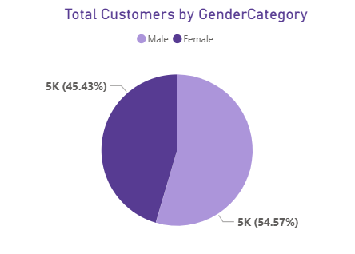
Number of Customers by Year
Male customers make up 54.57% (5.46K) of the total customer base, forming the slight majority.
Female customers account for 45.43% (4.54K), reflecting a relatively balanced gender distribution overall.
The near-equal split allows for gender-neutral marketing strategies or tailored campaigns to improve engagement from both segments.

Slide 10
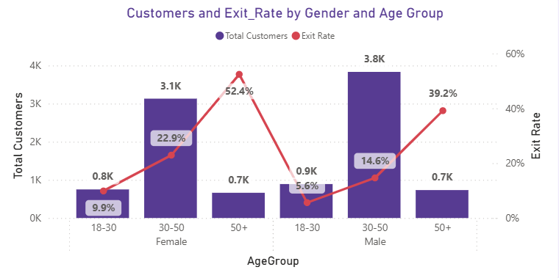
Customers and Churn Rate by Gender and Age
Females aged 50+ have the highest churn risk (52.4%), demanding urgent retention strategies.
Males aged 50+ also show elevated churn (39.2%) despite a small customer base.
Males aged 30–50 form the largest customer segment (3.8K) with moderate churn (14.6%), making them a key target for growth.
Younger customers (18–30) of both genders have the lowest churn (5.6%–9.9%), indicating strong loyalty and long-term potential.

Slide 11
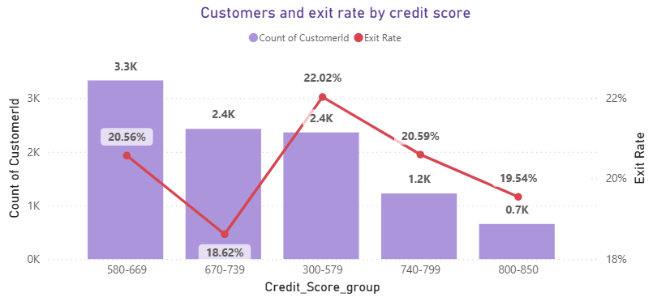
Customers and Churn Rate by Credit Score
Customers with low credit scores (300–579) have the highest churn rate (22%), indicating high risk.
Highest customer volume (3.3K) is in the 580–669 range with a churn rate of 20.6%, slightly above average.
Best retention (19.5%) is seen in the 800–850 score range, though this segment has the lowest customer count (0.7K).
Mid-credit range (670–739) shows lowest churn (18.6%) among larger groups, making it the most stable customer segment.

Slide 12
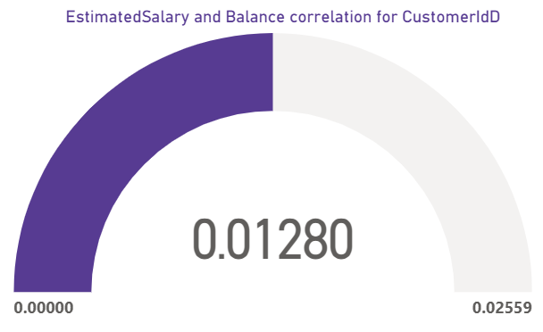
Correlation Insight – Salary vs. Balance
The correlation between Estimated Salary and Balance is very low (0.0128).
This indicates almost no linear relationship, meaning a customer’s salary does not significantly impact their account balance.

Slide 13
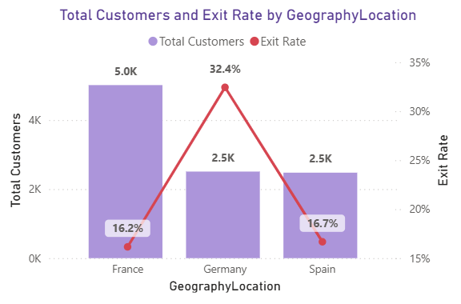
Churn Risk by Country – Geography Insight
Customers with low credit scores (300–579) have the highest churn rate (22%), indicating high risk.
Highest customer volume (3.3K) is in the 580–669 range with a churn rate of 20.6%, slightly above average.
Best retention (19.5%) is seen in the 800–850 score range, though this segment has the lowest customer count (0.7K).
Mid-credit range (670–739) shows lowest churn (18.6%) among larger groups, making it the most stable customer segment.

Slide 14
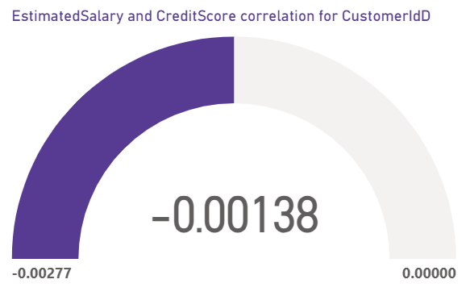
Correlation Insight – Salary vs. Credit Score
The correlation is nearly zero (-0.00138), indicating no significant relationship between a customer's estimated salary and their credit score.
This suggests that higher salaries do not correspond to better credit scores, and vice versa.

Slide 15
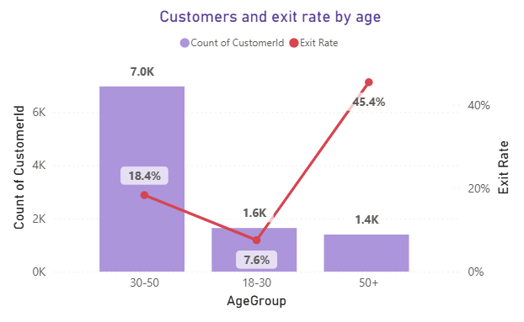
Customers and Churn Rate by Age
50+ group shows the highest churn (45.4%), despite being the smallest segment — indicating strong dissatisfaction and a clear need for targeted retention.
18–30 group has the lowest churn (7.6%), making them the most stable and satisfied customers.
30–50 group is the largest segment (7K customers) with a moderate churn rate (18.4%), meaning improvements here will have the biggest overall impact.
The sharp rise in churn from younger to older groups suggests older customers need more support and tailored products.

Slide 16
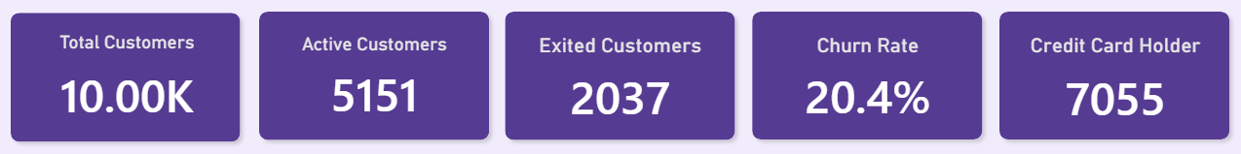
KPI Insights Summary
Total Customers: 10K – solid customer base.
Active Customers: 5,151 (51.5%) – moderate engagement.
Exited Customers: 2,037 – aligns with churn rate.
Churn Rate: 20.4% – relatively high; retention improvement needed.
Credit Card Holders: 7,055 (70.5%) – strong financially active segment.
Overall: Good customer volume but high churn. Focus on boosting retention and engagement, especially among credit card users.

Slide 17
Dashboard Snippets

Slide 18
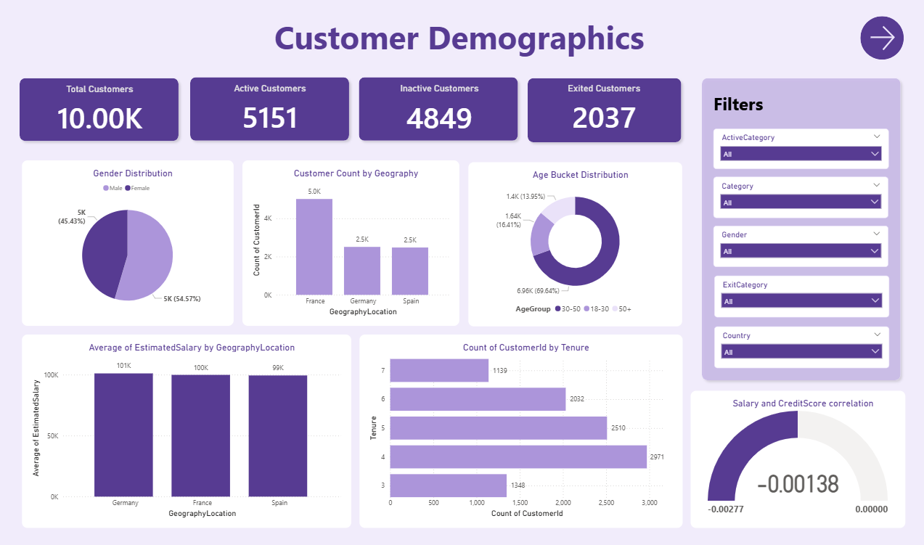

Slide 19
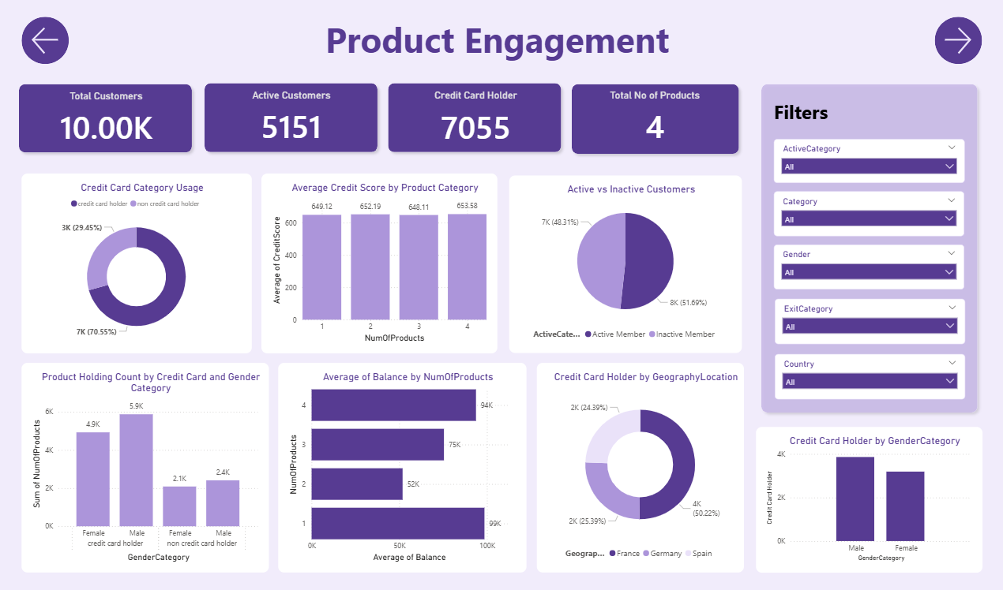

Slide 20
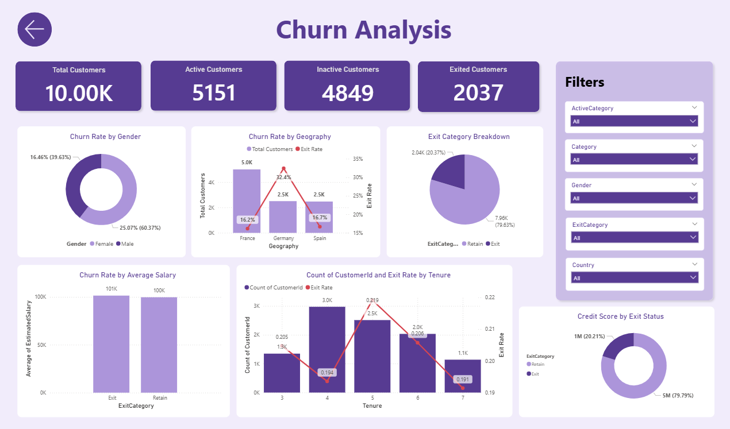
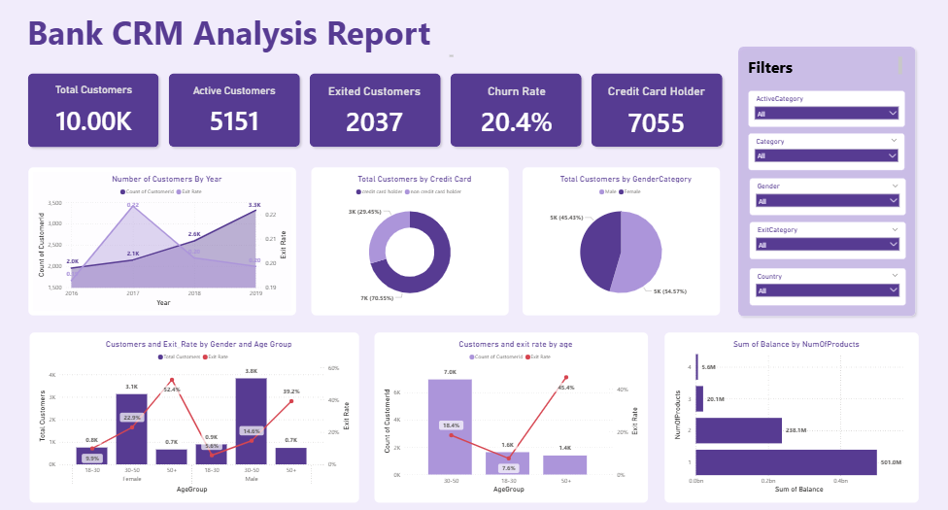

Slide 22
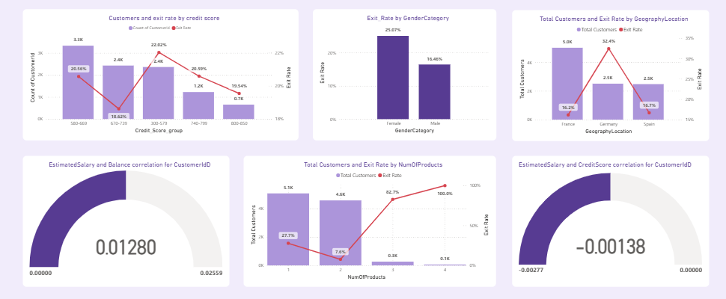

Slide 23
Challenges Faced
Limited Data Availability: Obtaining comprehensive datasets for analysis proved challenging, since several crucial variables were absent, which limited the breadth of insights that could be obtained.
Technical Restrictions: Due to the limitations of the technologies at hand, it was difficult to carry out intricate analyses or put sophisticated machine learning algorithms into practice.
Complexity of Analysis: Understanding complex connections and trends in the data was necessary for analyzing customer behavior and forecasting churn, which called for advanced analytical techniques and cautious result interpretation.
Overcoming Obstacles: Overcoming these obstacles required using iterative problem-solving strategies, making the most of the resources at hand, and cultivating a resilient and adaptive attitude to deal with uncertainty.

Slide 24
Recommendations
Focus retention efforts on females aged 50+ and German customers, as they show the highest churn rates.
Launch personalized upselling campaigns for single-product holders and non-credit card users to deepen engagement.
Strengthen loyalty programs for the 30–50 male segment, the largest and moderately stable group.
Promote and reward behavior seen in mid-credit score groups (670–739) to maintain their low churn.
Salary-based targeting should be avoided, as salary has minimal impact on both balance and credit score.
Prioritize France and Spain for expansion, as both show strong customer loyalty with manageable churn rates.

Slide 25
Conclusion
Churn is highest among females 50+ (52.4%) and Germans (32.4%), needing focused retention strategies.
Young customers (18–30) and those with mid credit scores (670–739) show the lowest churn, indicating loyalty.
France has the strongest market presence with high customer volume and low exit rate (16.2%).
Most customers hold only 1 product but contribute the highest balance, highlighting upsell potential.
Non-credit card holders (29.45%) are a key group for cross-sell strategies.
Salary has no correlation with credit score or balance, suggesting it's not a useful predictor for churn or financial behavior.

Slide 26
Thank You!

